Slide 1
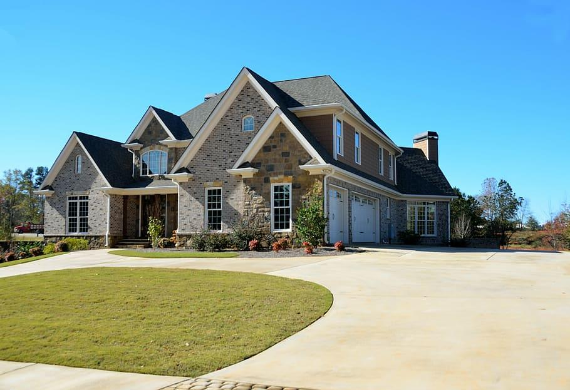
The Problem We’re Solving
Traditional home inspections are manual and time-consuming
Missed defects lead to high repair costs
No smart system to track & categorize issues visually

Slide 2
Our AI-Powered Solution
Multimodal Analysis of Documents, Photos and Videos
Computer Vision Pattern Detections
Automated Categorization of Issues, Severities, Fix and Costs
Recommendations, Vendor Selection, Appointments Scheduler, etc

